Slide 1

TEAM MEMBERS
R. Khatana
Akshay Kumar
Vikash Bagari
Shalini chourasia
TEAM NO - 61

Slide 2
What is Learning-Analytics?
Learning analytics is the measurement, collection, analysis, and reporting of data about learners, learning experiences, and learning programs for purposes of understanding and optimizing learning and its impact on an organization’s performance.
In a corporate context, learning analytics ultimately serves the purpose of improving organizational performance.

Slide 3
Overview of Project
We have solved the problem of analyzing the performance of students.
We know that every organization(schools ,colleges, universities) rank is based on the performance and talent of their students. So, it is essential to upgrade and track the performance of their students by showing and recommending their weak area and strong areas.
This project is helpful for students to recognize their weak and strong areas in all subjects and also helpful for teachers to find their students performance so that according to the result they can upgrade and work on the students.

Slide 4
In this project, we are analyzing the students level of understanding and performance by taking quiz of questions and answers.
Quiz would be based on the multiple choice questions and students have to choose one answer. Questions will randomly generate from the dataset in every quiz and they will be from different passages and different topics.
For the quiz, teachers will use simplicity or we can say as level of the quiz based on the level of understanding of different students.
In the quiz, 4 features are there :
1). When students give correct answers , model will show ‘correct’
and add marks of that question in right score.
2). When students give incorrect answers, models will show
‘incorrect’ and give the correct answer there and give negative
marks in wrong score.
3). Students can also skip the question if he doesn’t know the answer.
4). Negative marking is also applied. So, Score board also counts on
the basis of negative marking.

Slide 5
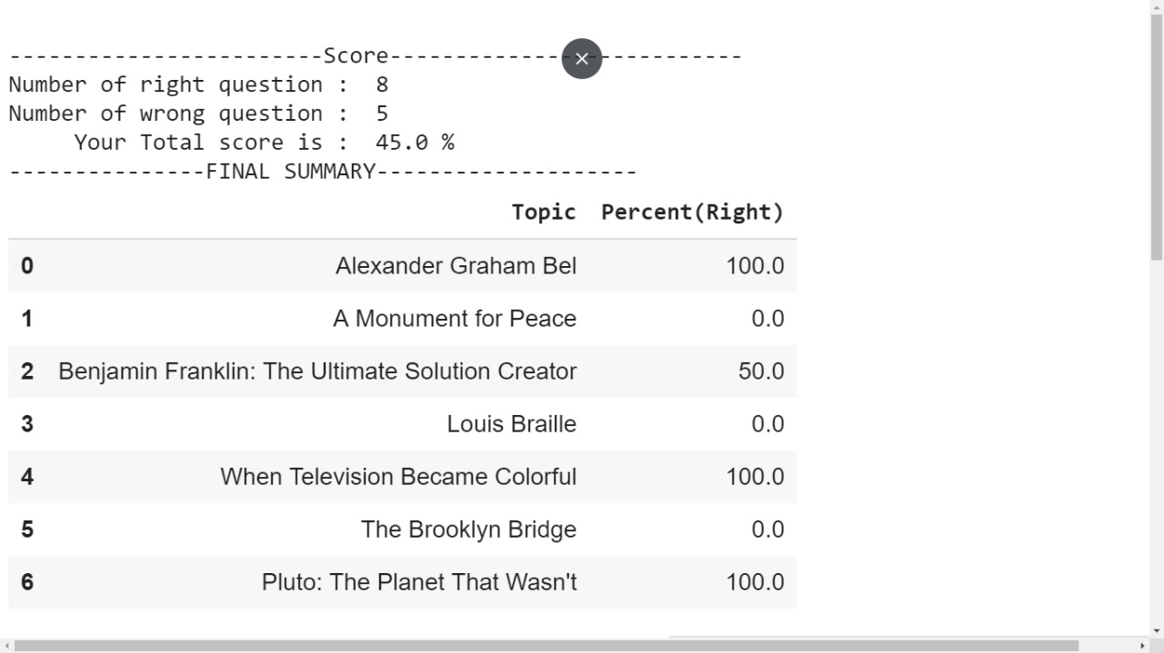
After the successful completion of quiz, model will generate the score board. Here we attach the screenshot of score board :-

Slide 6
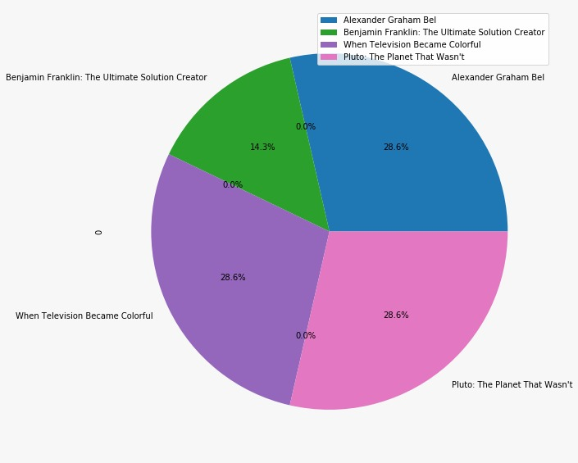
Score board in presentable form:

Slide 7
THANK YOU

